Slide 1
Predicting the Severity of Collisions
An analysis of data from Seattle, WA
Lucas Kramer

Slide 2
Predicting the severity of collisions is useful to many industries and other groups
Insurance companies can use this information to make informed decision about who to offer insurance to and what to charge them.
Healthcare companies can use this information to help predict when accidents can occur and make sure they have enough supplies and personnel to handle the new patients.
Cities and States would be able to use this information to increase emergency preparedness and also make informed decisions about infrastructure changes and improvements.
Motor vehicle companies and repair shops can use this to help plan inventory to repair or replace vehicles that are damaged.

Slide 3
Data acquisition and Cleaning
The data used is from Seattle, WA about collisions that occurred between Jan 2004 and May 2020.
After cleaning the data there were 187548 collisions that could be analyzed and 26 variables that were determined to be able to possibly predict the severity of the collisions.

Slide 4
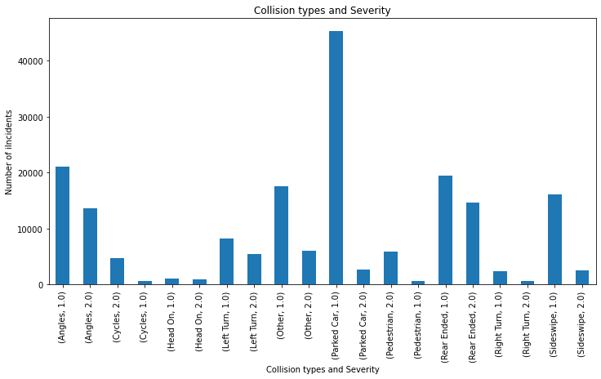
Collision Types And severity

Slide 5
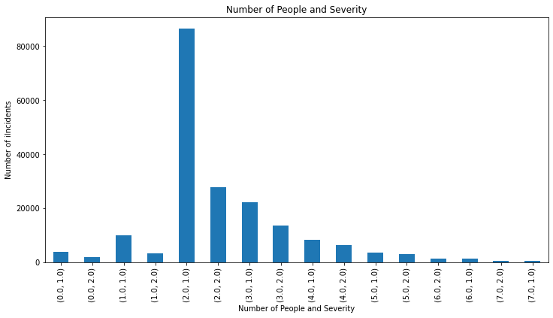
Number of People And severity

Slide 6
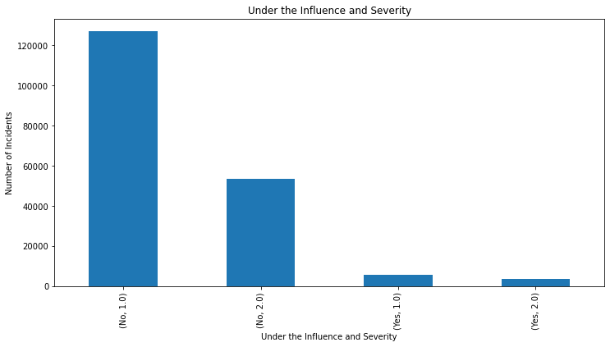
People Under the Influence And severity

Slide 7
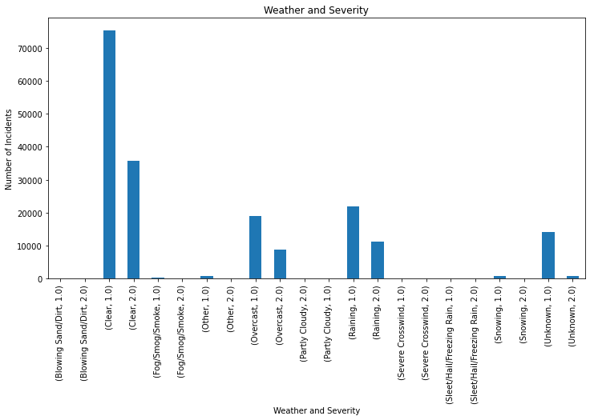
Weather And severity

Slide 8
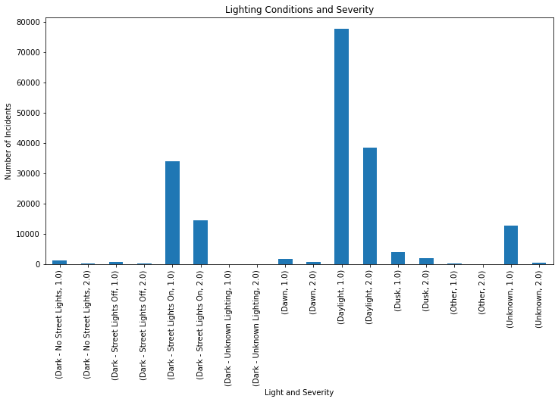
Lighting Conditions And severity

Slide 9
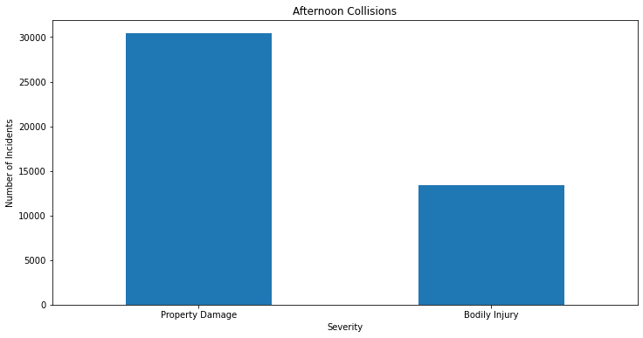
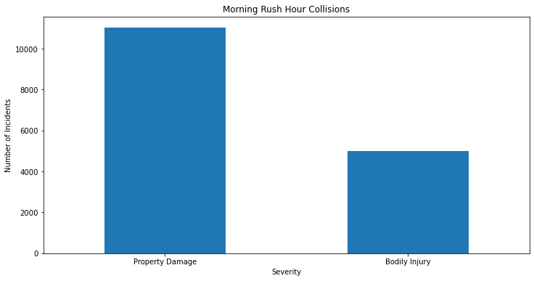
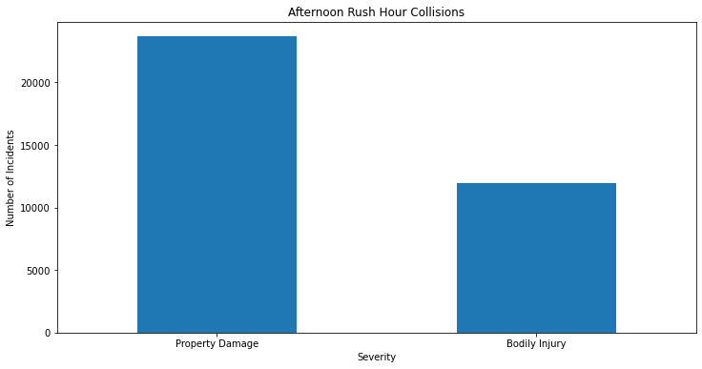
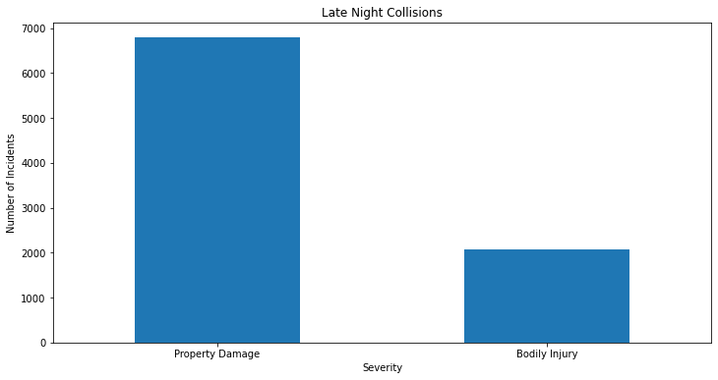
Times of Day And severity

Slide 10
Times of Day And severity

Slide 11
K-nearest Neighbor
This model predicts the outcome of a collision based on the closest neighbors in the data.
We found that by considering the closest 8 neighbors, we were able to predict the outcome 70% of the time.

Slide 12
Decision Tree
This model determines which variables split the data more accurately as fast as possible.
We found that by using 6 variables, we were able to accurately predict the outcome of the collision 71-75% of the time.
These variables include hitting a parked car, the number of people involved in the collision, if a driver was under the influence of alcohol or drugs, the angle of collision, and the levels of daylight where most indicative of the collision outcome.

Slide 13
Conclusion
We build successful models that can be used to predict the outcomes of collisions over 70% of the time.
More analysis can be done to include location details
Data about individuals can be used help predict severity

